Slide 1

STRATEGY FOR MANAGING CONTENT ON
Social media

Slide 2
Table of contents
3
Set Clear Goals
4
Audience Research
5
Platform Selection
6
Engaging Content Creation
7
Metrics Tracking
8
Editorial Calendar
9
Continuous Improvement

Slide 3
Set Clear Goals
Establish precise and targeted objectives for your content.
Are you aiming to increase brand awareness, drive traffic?
Are you aiming to boost conversions?

Slide 4
Audience Research
INTERESTS
Understand the preferences and needs of your target audience
PAIN POINTS
PREFERENCES

Slide 5
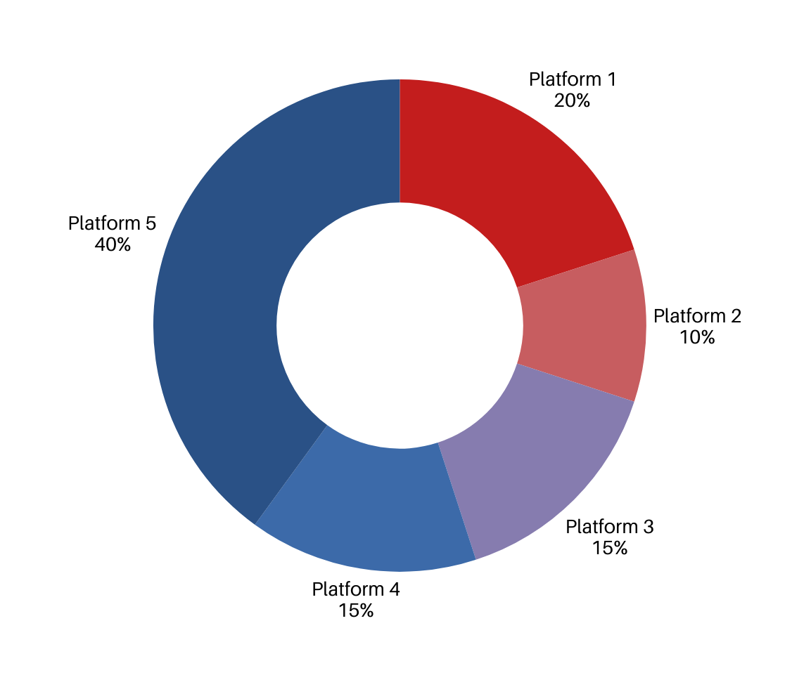
Platform Selection
Choose platforms where your target audience is most active

Slide 6
Engaging Content Creation
Create valuable and relevant content. Use a mix of formats (articles, videos, infographics) to keep your audience engaged.

Slide 7
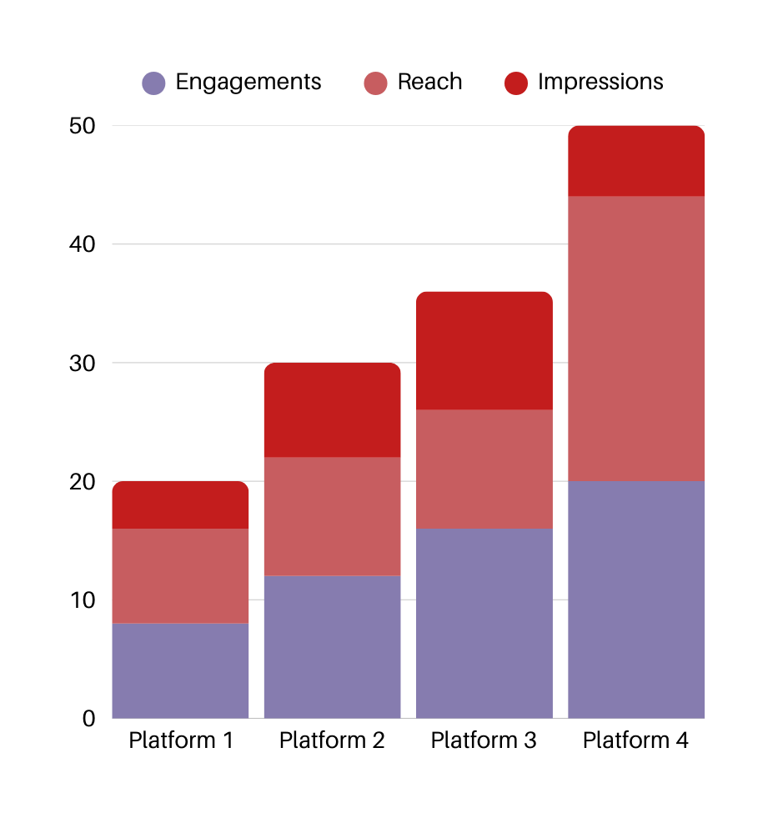
Metrics Tracking
Set up analytics tools to measure performance

Slide 8
Editorial Calendar
TOPIC
Plan content in advance
PUBLISHING DATE
PROMOTION STRATEGIES

Slide 9
Continuous Improvement
Regularly assess your strategy
What’s working?
What needs adjustment?
Adapt and refine based on feedback and results

Slide 10
Thank you
WWW.REALLYGREATSITE.COM

